Slide 1
Judging Debates
András Meleg
09 November 2020

Slide 2
Layout
Relevance
Why to judge?
Basic rules
Comparing opening and closing teams
Mentality
Fairness
Comparing the diagonals
Clashpoints
Panel discussion

Slide 3
Why do we have this workshop?

Slide 4
Why do we have this workshop?
Speaker
approach
transparency
Judge
confidence
transparency
Observer
understand

Slide 5
Why do we have this workshop?
Speaker
approach
transparency
Judge
confidence
transparency
Observer
understand
Don’t forget, in the end, debating is still subjective!

Slide 6
Relevance
Judging
Relevant part of debates
Limited material
Speaking
Focusing on spakers
Therefore usually judges make workshops
Good speakers retire to be judges later
Most people start with speaking
Juding is an advanced part of Debateland!
It’s very hard to master it!

Slide 7
Layout
Relevance
Why to judge?
Basic rules
Comparing opening and closing teams
Mentality
Fairness
Comparing the diagonals
Clashpoints
Panel discussion

Slide 8
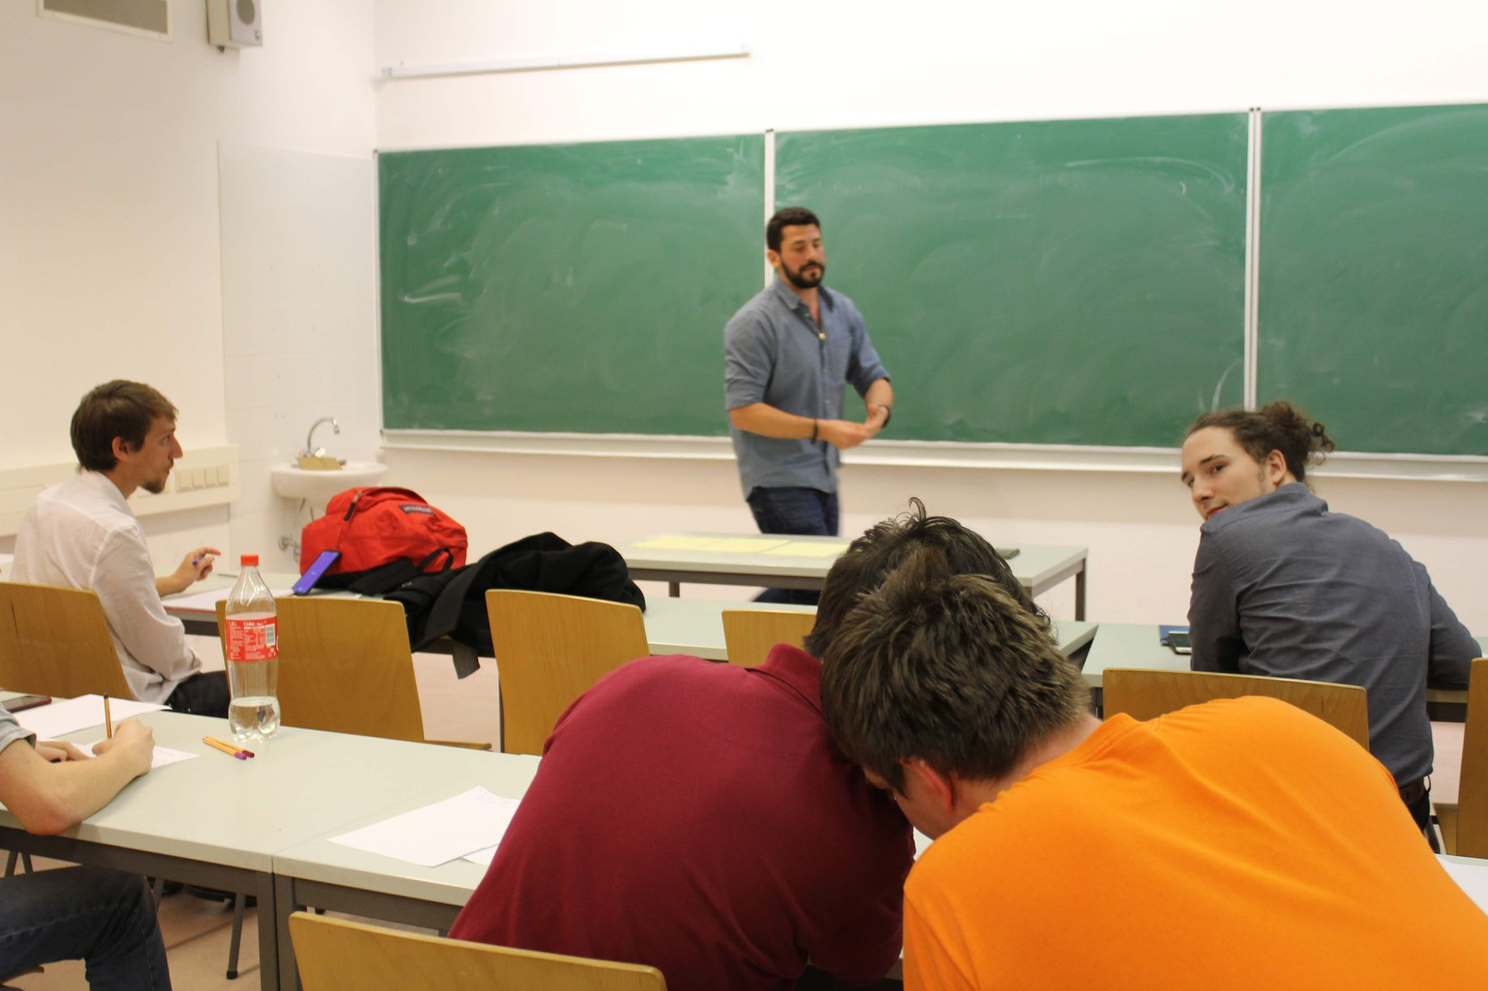
Why to be a judge?
Judging
Speaking
The experts should be judges
You want to convince people, not to judge them
Speaking is a more active role

Slide 9
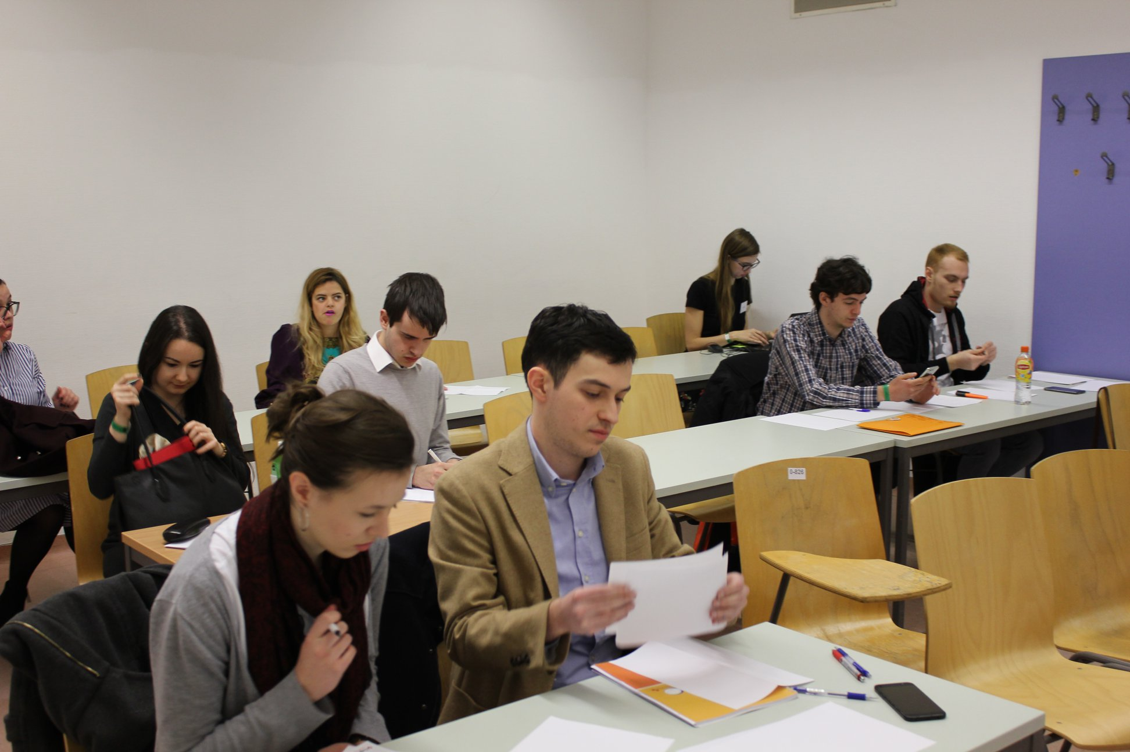
Why to be a judge?
Judging
Speaking
The experts should be judges
You want to convince people, not to judge them
Speaking is a more active role
Access to and discussion with very strong debaters / judges

Slide 10
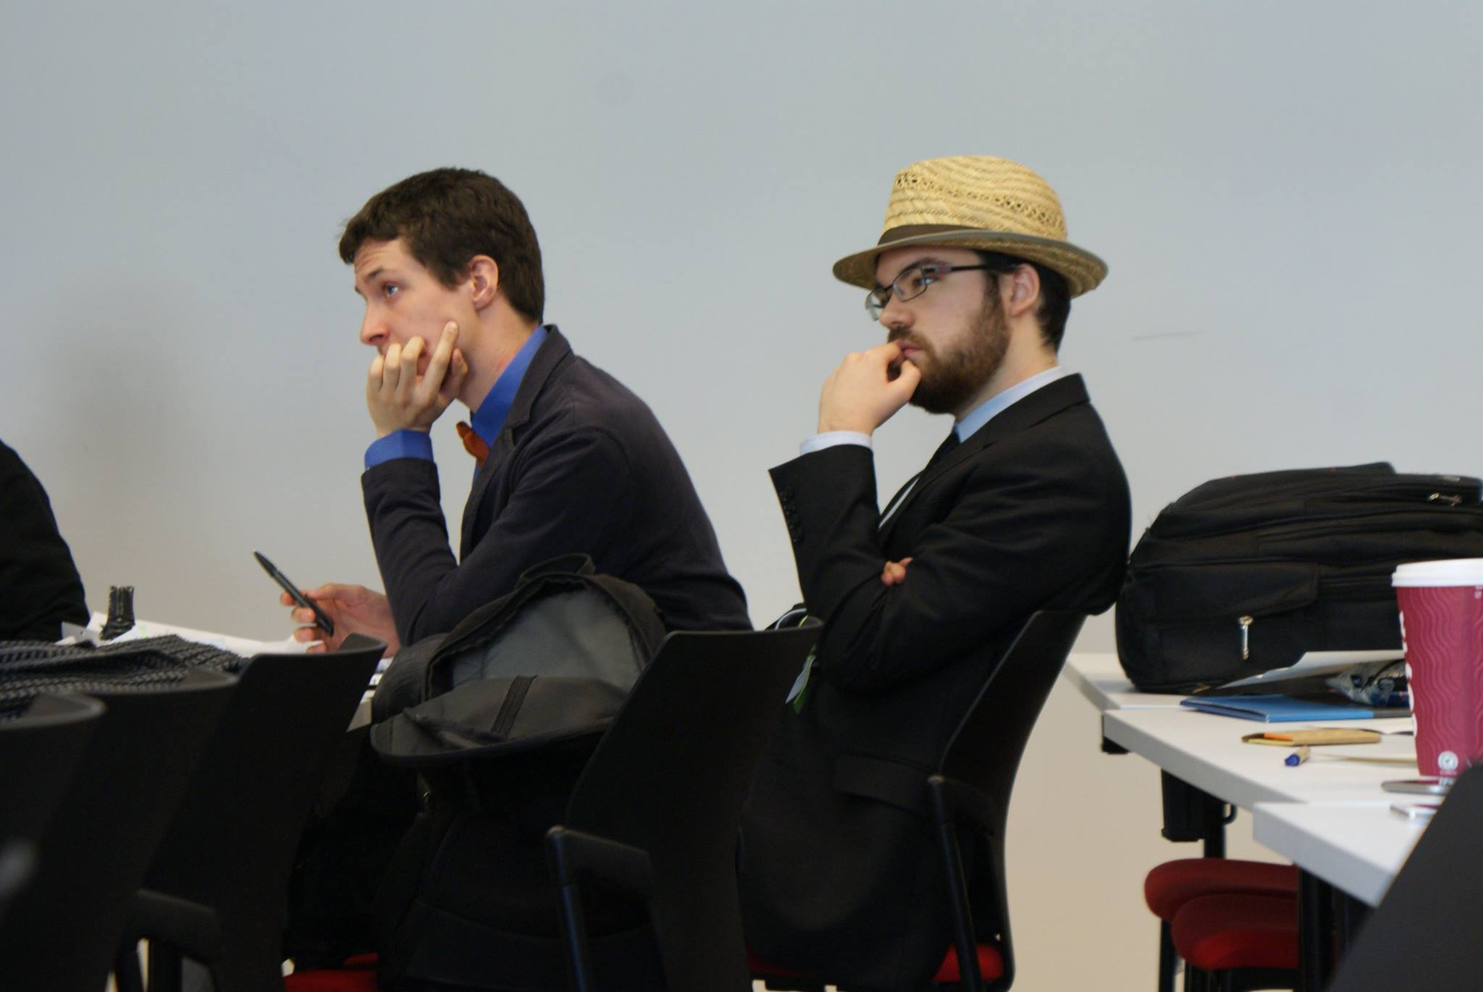
Why to be a judge?
Judging
Speaking
The experts should be judges
You want to convince people, not to judge them
Speaking is a more active role
Access to and discussion with very strong debaters / judges
Clearer perspective: mistakes, comparatives, structure

Slide 11
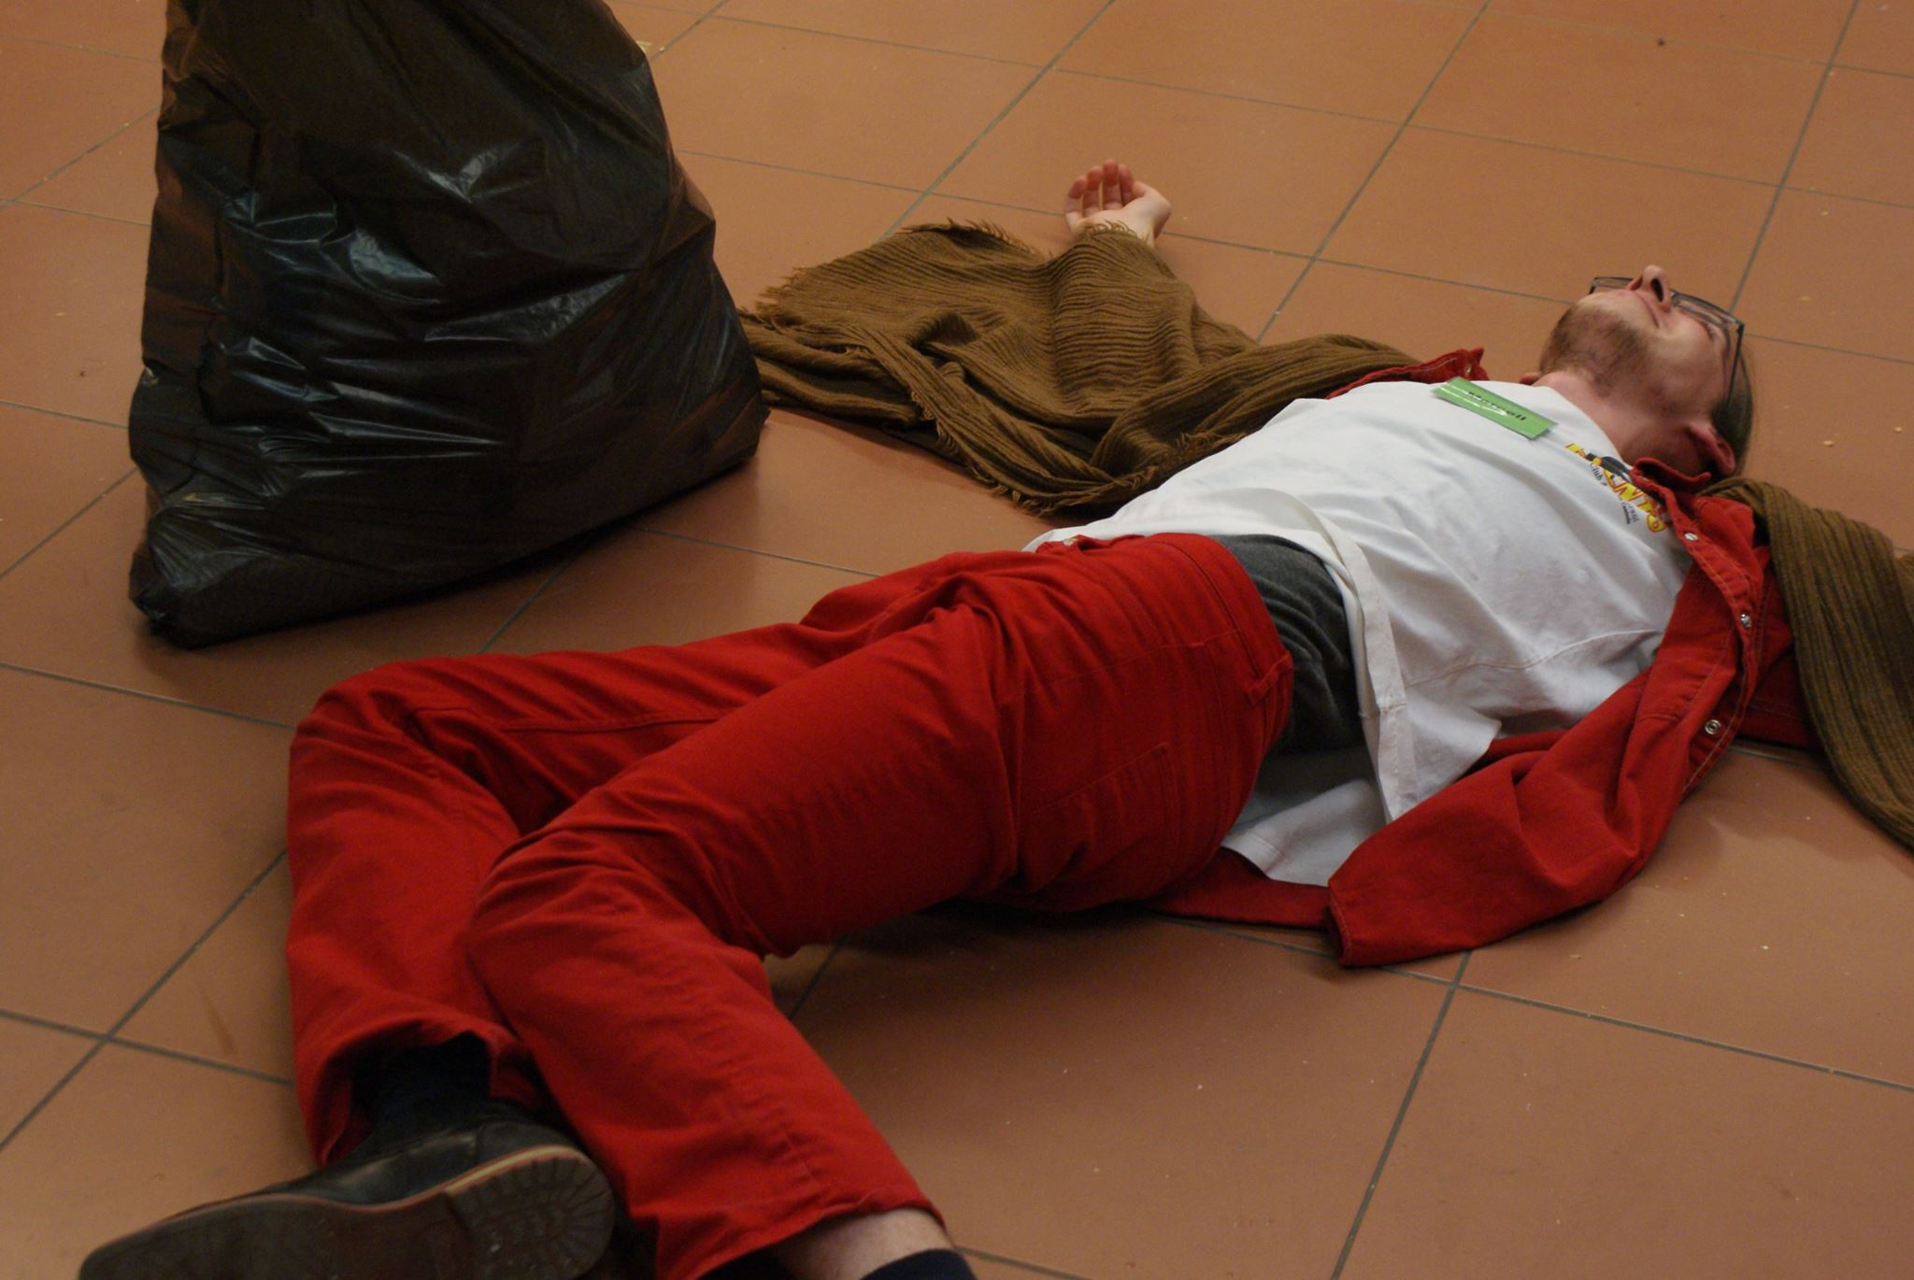
Why to be a judge?
Judging
Speaking
The experts should be judges
You want to convince people, not to judge them
Speaking is a more active role
Access to and discussion with very strong debaters / judges
Clearer perspective: mistakes, comparatives, structure
Engagement without the nerves

Slide 12

Why to be a judge?
Judging
Speaking
The experts should be judges
You want to convince people, not to judge them
Speaking is a more active role
Access to and discussion with very strong debaters / judges
Clearer perspective: mistakes, comparatives, structure
Engagement without the nerves
International tournaments are cheaper for judges

Slide 13
Layout
Relevance
Why to judge?
Basic rules
Comparing opening and closing teams
Mentality
Fairness
Comparing the diagonals
Clashpoints
Panel discussion

Slide 14
Basic rules for judging
Judges judge according to the latest WUDC / EUDC guidelines
Goal: make it easier for the judge to decide
In Brittish Parliamentary:
First the teams are ranked from 1 to 4th
Then all speakers get speaker points between 65-85
Flow of discussion:
The motion is announced → judges may consult with Chief Adjudicator team
The Debate starts: judges give no indication for the debaters
After the debate: 15 minutes to make the decision
After the decision: 15 minutes to give feedback
Therefore a whole debate takes approx. 105 minutes (15 + 60 + 15 + 15)

Slide 15
Basic rules for judging
Judges judge according to the latest WUDC / EUDC guidelines
Goal: make it easier for the judge to decide
In Brittish Parliamentary:
First the teams are ranked from 1 to 4th
Then all speakers get speaker points between 65-85
Flow of discussion:
The motion is announced → judges may consult with Chief Adjudicator team
The Debate starts: judges give no indication for the debaters
After the debate: 15 minutes to make the decision
After the decision: 15 minutes to give feedback
Therefore a whole debate takes approx. 105 minutes (15 + 60 + 15 + 15)

Slide 16
Basic rules for judging
Judges judge according to the latest WUDC / EUDC guidelines
Goal: make it easier for the judge to decide
In Brittish Parliamentary:
First the teams are ranked from 1 to 4th
Then all speakers get speaker points between 65-85
Flow of discussion:
The motion is announced → judges may consult with Chief Adjudicator team
The Debate starts: judges give no indication for the debaters
After the debate: 15 minutes to make the decision
After the decision: 15 minutes to give feedback
Therefore a whole debate takes approx. 105 minutes (15 + 60 + 15 + 15)

Slide 17
Basic rules for judging
Judges judge according to the latest WUDC / EUDC guidelines
Goal: make it easier for the judge to decide
In Brittish Parliamentary:
First the teams are ranked from 1 to 4th
Then all speakers get speaker points between 65-85
Flow of discussion:
The motion is announced → judges may consult with Chief Adjudicator team
The Debate starts: judges give no indication for the debaters
After the debate: 15 minutes to make the decision
After the decision: 15 minutes to give feedback
Therefore a whole debate takes approx. 105 minutes (15 + 60 + 15 + 15)

Slide 18
Basic rules for judging
Judges judge according to the latest WUDC / EUDC guidelines
Goal: make it easier for the judge to decide
In Brittish Parliamentary:
First the teams are ranked from 1 to 4th
Then all speakers get speaker points between 65-85
Flow of discussion:
The motion is announced → judges may consult with Chief Adjudicator team
The Debate starts: judges give no indication for the debaters
After the debate: 15 minutes to make the decision
After the decision: 15 minutes to give feedback
Therefore a whole debate takes approx. 105 minutes (15 + 60 + 15 + 15)

Slide 19
Basic rules for judging
Judges judge according to the latest WUDC / EUDC guidelines
Goal: make it easier for the judge to decide
In Brittish Parliamentary:
First the teams are ranked from 1 to 4th
Then all speakers get speaker points between 65-85
Flow of discussion:
The motion is announced → judges may consult with Chief Adjudicator team
The Debate starts: judges give no indication for the debaters
After the debate: 15 minutes to make the decision
After the decision: 15 minutes to give feedback
Therefore a whole debate takes approx. 105 minutes (15 + 60 + 15 + 15)

Slide 20
Basic rules for judging
Judges judge according to the latest WUDC / EUDC guidelines
Goal: make it easier for the judge to decide
In Brittish Parliamentary:
First the teams are ranked from 1 to 4th
Then all speakers get speaker points between 65-85
Flow of discussion:
The motion is announced → judges may consult with Chief Adjudicator team
The Debate starts: judges give no indication for the debaters
After the debate: 15 minutes to make the decision
After the decision: 15 minutes to give feedback
Therefore a whole debate takes approx. 105 minutes (15 + 60 + 15 + 15)

Slide 21
Basic rules for judging
Judges judge according to the latest WUDC / EUDC guidelines
Goal: make it easier for the judge to decide
In Brittish Parliamentary:
First the teams are ranked from 1 to 4th
Then all speakers get speaker points between 65-85
Flow of discussion:
The motion is announced → judges may consult with Chief Adjudicator team
The Debate starts: judges give no indication for the debaters
After the debate: 15 minutes to make the decision
After the decision: 15 minutes to give feedback
Therefore a whole debate takes approx. 105 minutes (15 + 60 + 15 + 15)

Slide 22
Basic rules for judging
Judges judge according to the latest WUDC / EUDC guidelines
Goal: make it easier for the judge to decide
In Brittish Parliamentary:
First the teams are ranked from 1 to 4th
Then all speakers get speaker points between 65-85
Flow of discussion:
The motion is announced → judges may consult with Chief Adjudicator team
The Debate starts: judges give no indication for the debaters
After the debate: 15 minutes to make the decision
After the decision: 15 minutes to give feedback
Therefore a whole debate takes approx. 105 minutes (15 + 60 + 15 + 15)

Slide 23
Basic rules for judging
Judges judge according to the latest WUDC / EUDC guidelines
Goal: make it easier for the judge to decide
In Brittish Parliamentary:
First the teams are ranked from 1 to 4th
Then all speakers get speaker points between 65-85
Flow of discussion:
The motion is announced → judges may consult with Chief Adjudicator team
The Debate starts: judges give no indication for the debaters
After the debate: 15 minutes to make the decision
After the decision: 15 minutes to give feedback
Therefore a whole debate takes approx. 105 minutes (15 + 60 + 15 + 15)

Slide 24
Basic rules for judging
Judges judge according to the latest WUDC / EUDC guidelines
Goal: make it easier for the judge to decide
In Brittish Parliamentary:
First the teams are ranked from 1 to 4th
Then all speakers get speaker points between 65-85
Flow of discussion:
The motion is announced → judges may consult with Chief Adjudicator team
The Debate starts: judges give no indication for the debaters
After the debate: 15 minutes to make the decision
After the decision: 15 minutes to give feedback
Therefore a whole debate takes approx. 105 minutes (15 + 60 + 15 + 15)

Slide 25
Let’s dig into BP: someone has to win
1st place | 3 points
2nd place | 2 points
3rd place | 1 points
4th place | 0 points
Opening Government
Opening Opposition
1st place | 2 points
2nd place | 2 points
3rd place | 2 points
4th place | 0 points
Not possible!
Closing Government
Closing Opposition
1st place | 2 points
2nd place | 2 points
3rd place | 1 points
4th place | 1 points
Not possible!
The „more arrows” flip towards you, the more points you have. There can’t be ties!

Slide 26
Layout
Relevance
Why to judge?
Basic rules
Comparing opening and closing teams
Mentality
Fairness
Comparing the diagonals
Clashpoints
Panel discussion

Slide 27
Who wins the Debate?
- Persuade the average reasonable voter:
- NOT specialists
Judge: knowledge with the average reasonable voter
There is Civil War in Syria
Doesn’t know who fights whom in Syria
The European Union started as a Free Trade Union and today has 27 countries
Doesn’t know which is the strongest fraction in the EU Parliament and how it differs from the EU Committee
Joe Biden is the current president-elect of the US
Doesn’t know why mail-in votes get counted more slowly during the 2020 US election

Slide 28
Who wins the Debate?
- Persuade the average reasonable voter:
- NOT specialists
Judge: knowledge with the average reasonable voter
There is Civil War in Syria
Doesn’t know who fights whom in Syria
The European Union started as a Free Trade Union and today has 27 countries
Doesn’t know which is the strongest fraction in the EU Parliament and how it differs from the EU Committee
Joe Biden is the current president-elect of the US
Doesn’t know why mail-in votes get counted more slowly during the 2020 US election

Slide 29
Who wins the Debate?
- Persuade the average reasonable voter:
- NOT specialists
Judge: knowledge with the average reasonable voter
There is Civil War in Syria
Doesn’t know who fights whom in Syria
The European Union started as a Free Trade Union and today has 27 countries
Doesn’t know which is the strongest faction in the EU Parliament and how it differs from the EU Committee
Joe Biden is the current president-elect of the US
Doesn’t know why mail-in votes get counted more slowly during the 2020 US election

Slide 30
Layout
Relevance
Why to judge?
Basic rules
Comparing opening and closing teams
Mentality
Fairness
Comparing the diagonals
Clashpoints
Panel discussion

Slide 31
Fairness
Why do we have rules?
Most rules are not explicit rules, more like conviction
„some things are persuasive, but not fair”
Examples of not being fair:
Opening Government reveals model in 2nd speech → harder to challenge for OO
Closing team gives extenstion of the debate in 2nd speech → kindof impossible to challenge for other teams
We want to regulate doping in all sports, but we specify the whole issue to doping in football, (narrowing the case)

Slide 32
Fairness
Why do we have rules?
Most rules are not explicit rules, more like conviction
„some things are persuasive, but not fair”

Slide 33
Fairness
Why do we have rules?
Most rules are not explicit rules, more like conviction
„some things are persuasive, but not fair”
Examples of not being fair:
Opening Government reveals model in 2nd speech → harder to challenge for OO
Closing team gives extenstion of the debate in 2nd speech → kindof impossible to challenge for other teams
We want to regulate doping in all sports, but we specify the whole issue to doping in football, (narrowing the case)

Slide 34
Fairness
Why do we have rules?
Most rules are not explicit rules, more like conviction
„some things are persuasive, but not fair”
Examples of not being fair:
Opening Government reveals model in 2nd speech → harder to challenge for OO
Closing team gives extenstion of the debate in 2nd speech → kind of impossible to challenge for other teams
We want to regulate doping in all sports, but we specify the whole issue to doping in football, (narrowing the case)

Slide 35
Fairness
Why do we have rules?
Most rules are not explicit rules, more like conviction
„some things are persuasive, but not fair”
Examples of not being fair:
Opening Government reveals model in 2nd speech → harder to challenge for OO
Closing team gives extenstion of the debate in 2nd speech → kindof impossible to challenge for other teams
We want to regulate doping in all sports, but we specify the whole issue to doping in football, (narrowing the case)

Slide 36
Proposition side
Opposition side
The Debate
„Spirit of motion” = the balance

Slide 37
Fairness
Spirit of the motion
There is a reason, why we debate about something
Opening Government usually starts with core definitions for the Debate.
Opposition only may challenge, when it’s impossible to have a fair debate
only first opposition speaker may challenge (unless def creates problem later)
Why it makes for an unfair debate?
Would it really make for an unfair debate?
Example: THW allow the students to vote on the curriculum.
OG: „We are talking about university students only”
CG: „We should rather talk about students in non-tertiary education too, because university students already voted with their choice of studies yet”
Question: What do we think about this now? What’s the spirit of the motion?
OO: Could the first opposition speaker challenge this definitionM

Slide 38
Fairness
Spirit of the motion
There is a reason, why we debate about something
Opening Government usually starts with core definitions for the Debate.
Opposition only may challenge, when it’s impossible to have a fair debate
only first opposition speaker may challenge (unless def creates problem later)
Why it makes for an unfair debate?
Would it really make for an unfair debate?
Example: THW allow the students to vote on the curriculum.
OG: „We are talking about university students only”
CG: „We should rather talk about students in non-tertiary education too, because university students already voted with their choice of studies yet”
Question: What do we think about this now? What’s the spirit of the motion?
OO: Could the first opposition speaker challenge this definitionM

Slide 39
Fairness
Spirit of the motion
There is a reason, why we debate about something
Opening Government usually starts with core definitions for the Debate.
Opposition only may challenge, when it’s impossible to have a fair debate
only first opposition speaker may challenge (unless def creates problem later)
Why it makes for an unfair debate?
Would it really make for an unfair debate?
Example: THW allow the students to vote on the curriculum.
OG: „We are talking about university students only”
CG: „We should rather talk about students in non-tertiary education too, because university students already voted with their choice of studies yet”
Question: What do we think about this now? What’s the spirit of the motion?
OO: Could the first opposition speaker challenge this definitionM

Slide 40
Fairness
Spirit of the motion
There is a reason, why we debate about something
Opening Government usually starts with core definitions for the Debate.
Opposition only may challenge, when it’s impossible to have a fair debate
only first opposition speaker may challenge (unless def creates problem later)
Why it makes for an unfair debate?
Would it really make for an unfair debate?
Example: THW allow the students to vote on the curriculum.
OG: „We are talking about university students only”
CG: „We should rather talk about students in non-tertiary education too, because university students already voted with their choice of studies yet”
Question: What do we think about this now? What’s the spirit of the motion?
OO: Could the first opposition speaker challenge this definitionM

Slide 41
Fairness
Spirit of the motion
There is a reason, why we debate about something
Opening Government usually starts with core definitions for the Debate.
Opposition only may challenge, when it’s impossible to have a fair debate
only first opposition speaker may challenge (unless def creates problem later)
Why it makes for an unfair debate?
Would it really make for an unfair debate?
Example: THW allow the students to vote on the curriculum.
OG: „We are talking about university students only”
CG: „We should rather talk about students in non-tertiary education too, because university students already voted with their choice of studies yet”
Question: What do we think about this now? What’s the spirit of the motion?
OO: Could the first opposition speaker challenge this definition

Slide 42
Fairness
Spirit of the motion
There is a reason, why we debate about something
Opening Government usually starts with core definitions for the Debate.
Opposition only may challenge, when it’s impossible to have a fair debate
only first opposition speaker may challenge (unless def creates problem later)
Why it makes for an unfair debate?
Would it really make for an unfair debate?
Example: THW allow the students to vote on the curriculum.
OG: „We are talking about university students only”
CG: „We should rather talk about students in non-tertiary education too, because university students already voted with their choice of studies yet”
Question: What do we think about this now? What’s the spirit of the motion?
OO: Could the first opposition speaker challenge this definitionM

Slide 43
Fairness
Spirit of the motion
There is a reason, why we debate about something
Opening Government usually starts with core definitions for the Debate.
Opposition only may challenge, when it’s impossible to have a fair debate
only first opposition speaker may challenge (unless def creates problem later)
Why it makes for an unfair debate?
Would it really make for an unfair debate?
Example: THW allow the students to vote on the curriculum.
OG: „We are talking about university students only”
CG: „We should rather talk about students in non-tertiary education too, because university students already voted with their choice of studies yet”
Question: What do we think about this now? What’s the spirit of the motion?
OO: Could the first opposition speaker challenge this definitionM

Slide 44
Fairness
Spirit of the motion
There is a reason, why we debate about something
Opening Government usually starts with core definitions for the Debate.
Opposition only may challenge, when it’s impossible to have a fair debate
only first opposition speaker may challenge (unless def creates problem later)
Why it makes for an unfair debate?
Would it really make for an unfair debate?
Example: THW allow the students to vote on the curriculum.
OG: „We are talking about university students only”
CG: „We should rather talk about students in non-tertiary education too, because university students already voted with their choice of studies yet”
Question: What do we think about this now? What’s the spirit of the motion?
OO: Could the first opposition speaker challenge this definitionM

Slide 45
Fairness
Spirit of the motion
There is a reason, why we debate about something
Opening Government usually starts with core definitions for the Debate.
Opposition only may challenge, when it’s impossible to have a fair debate
only first opposition speaker may challenge (unless def creates problem later)
Why it makes for an unfair debate?
Would it really make for an unfair debate?
Example: THW allow the students to vote on the curriculum.
OG: „We are talking about university students only”
CG: „We should rather talk about students in non-tertiary education too, because university students already voted with their choice of studies yet”
Question: What do we think about this now? What’s the spirit of the motion?
OO: Could the first opposition speaker challenge this definition

Slide 46
Fairness
„It will never happen trick” → sometimes its comfortable to believe in this, but in many debates, the spirit of the motion assumes the possibility that we can reach the status ante from the status quo.
Example: „This House Would legalize marijuana”
It is inside the boundaries of the motion how this will effect a backlash among conservatives, and turn liberals and conservatives against each other, etc.
It is kinda out of the boundaries to assume that the legislation just won’t happen, because there are more conservatives than liberals.
„This House” is an abstract stakeholder: should we ←→ can we

Slide 47
Fairness
„It will never happen trick” → in most debates, the spirit of the motion assumes the possibility that we can reach the status ante from the status quo.
Example: „This House Would legalize marijuana”
It is inside the boundaries of the motion how this will effect a backlash among conservatives, and turn liberals and conservatives against each other, etc.
It is kinda out of the boundaries to assume that the legislation just won’t happen, because there are more conservatives than liberals.
„This House” is an abstract stakeholder: should we ←→ can we

Slide 48
Fairness
„It will never happen trick” → sometimes its comfortable to believe in this, but in many debates, the spirit of the motion assumes the possibility that we can reach the status ante from the status quo.
Example: „This House Would legalize marijuana”
It is inside the boundaries of the motion how this will effect a backlash among conservatives, and turn liberals and conservatives against each other, etc.
It is kinda out of the boundaries to assume that the legislation just won’t happen, because there are more conservatives than liberals.
„This House” is an abstract stakeholder: should we ←→ can we

Slide 49
Fairness
„It will never happen trick” → sometimes its comfortable to believe in this, but in many debates, the spirit of the motion assumes the possibility that we can reach the status ante from the status quo.
Example: „This House Would legalize marijuana”
It is inside the boundaries of the motion how this will effect a backlash among conservatives, and turn liberals and conservatives against each other, etc.
It is kinda out of the boundaries to assume that the legislation just won’t happen, because there are more conservatives than liberals.
„This House” is an abstract stakeholder: should we ←→ can we

Slide 50
Fairness
„It will never happen trick” → sometimes its comfortable to believe in this, but in many debates, the spirit of the motion assumes the possibility that we can reach the status ante from the status quo.
Example: „This House Would legalize marijuana”
It is inside the boundaries of the motion how this will effect a backlash among conservatives, and turn liberals and conservatives against each other, etc.
It is kinda out of the boundaries to assume that the legislation just won’t happen, because there are more conservatives than liberals.
„This House” is an abstract stakeholder: should we ←→ can we

Slide 51
Fairness
„It will never happen trick” → sometimes its comfortable to believe in this, but in many debates, the spirit of the motion assumes the possibility that we can reach the status ante from the status quo.
Example: „This House Would legalize marijuana”
It is inside the boundaries of the motion how this will effect a backlash among conservatives, and turn liberals and conservatives against each other, etc.
It is kinda out of the boundaries to assume that the legislation just won’t happen, because there are more conservatives than liberals.
„This House” is an abstract stakeholder: should we ←→ can we

Slide 52
Layout
Relevance
Why to judge?
Basic rules
Comparing opening and closing teams
Mentality
Fairness
Comparing the diagonals
Clashpoints
Panel discussion

Slide 53
Someone has to win
1st place | 3 points
2nd place | 2 points
3rd place | 1 points
4th place | 0 points
Opening Government
Opening Opposition
1st place | 2 points
2nd place | 2 points
3rd place | 2 points
4th place | 0 points
Closing Government
Closing Opposition
1st place | 2 points
2nd place | 2 points
3rd place | 1 points
4th place | 1 points
The „more arrows” flip towards you, the more points you have. There can’t be ties!

Slide 54
Someone has to win
1st place | 3 points
2nd place | 2 points
3rd place | 1 points
4th place | 0 points
Opening Government
Opening Opposition
1st place | 2 points
2nd place | 2 points
3rd place | 2 points
4th place | 0 points
Not possible!
Closing Government
Closing Opposition
1st place | 2 points
2nd place | 2 points
3rd place | 1 points
4th place | 1 points
Not possible!
The „more arrows” flip towards you, the more points you have. There can’t be ties!

Slide 55
Comparing opening and closing teams I- knifing and contradiction
Teams shouldn’t contradict with their opening
Don’t have to defend them either
Goal: distance themselves with more substantive arguments
Kinda like the Republican party after Trump lost the election

Slide 56


Comparing opening and closing teams I- knifing and contradiction
Teams shouldn’t contradict with their opening
Don’t have to defend them either
Goal: distance themselves with more substantive arguments
Kinda like the Republican party after Trump lost the election

Slide 57
Closing teams can (and should) only get credit for „new” content
Arguments
Rebuttal
Clash-analysis

Slide 58
Closing teams can (and should) only get credit for „new” content
Arguments
Rebuttal
Clash-analysis
Sometimes things are not flagged forward: the judge have to identify
Flagging is good, but not compulsary

Slide 59
Sounding nice < giving more new content
New material in final speech –> should be disregarded? Why?
Fairness!
It’s not about rules, it’s about having a good justice system in Debateland
You should bring you new content to the table a way, that the everyone has a chance to react for it
Example: super often the Hungarian government introduces a new law, they give around 12-24 hours for the public to discuss the text, before voting in Parliament (f.e.: Healthcare System reform this autumn, and 1000x other laws)
Takeaway: World is not fair. The judge has to understand this, when making the decision.
In the end: is there extension? Is it relevant?

Slide 60
Sounding nice < giving more new content
New material in final speech –> should be disregarded? Why?
Fairness!
It’s not about rules, it’s about having a good justice system in Debateland
You should bring you new content to the table a way, that the everyone has a chance to react for it
Example: super often the Hungarian government introduces a new law, they give around 12-24 hours for the public to discuss the text, before voting in Parliament (f.e.: Healthcare System reform this autumn, and 1000x other laws)
Takeaway: World is not fair. The judge has to understand this, when making the decision.
In the end: is there extension? Is it relevant?

Slide 61
Sounding nice < giving more new content
New material in final speech –> should be disregarded? Why?
Fairness!
It’s not about rules, it’s about having a good justice system in Debateland
You should bring you new content to the table a way, that the everyone has a chance to react for it
Example: super often the Hungarian government introduces a new law, they give around 12-24 hours for the public to discuss the text, before voting in Parliament (f.e.: Healthcare System reform this autumn, and 1000x other laws)
Takeaway: World is not fair. The judge has to understand this, when making the decision.
In the end: is there extension? Is it relevant?

Slide 62
Sounding nice < giving more new content
New material in final speech –> should be disregarded? Why?
Fairness!
It’s not about rules, it’s about having a good justice system in Debateland
You should bring you new content to the table a way, that the everyone has a chance to react for it
Example: super often the Hungarian government introduces a new law, they give around 12-24 hours for the public to discuss the text, before voting in Parliament (f.e.: Healthcare System reform this autumn, and 1000x other laws)
Takeaway: World is not fair. The judge has to understand this, when making the decision.
In the end: is there extension? Is it relevant?

Slide 63
Sounding nice < giving more new content
New material in final speech –> should be disregarded? Why?
Fairness!
It’s not about rules, it’s about having a good justice system in Debateland
You should bring you new content to the table a way, that the everyone has a chance to react for it
Example: super often the Hungarian government introduces a new law, they give around 12-24 hours for the public to discuss the text, before voting in Parliament (f.e.: Healthcare System reform this autumn, and 1000x other laws)
Takeaway: World is not fair. The judge has to understand this, when making the decision.
In the end: is there extension? Is it relevant?

Slide 64
Sounding nice < giving more new content
New material in final speech –> should be disregarded? Why?
Fairness!
It’s not about rules, it’s about having a good justice system in Debateland
You should bring you new content to the table a way, that the everyone has a chance to react for it
Example: super often the Hungarian government introduces a new law, they give around 12-24 hours for the public to discuss the text, before voting in Parliament (f.e.: Healthcare System reform this autumn, and 1000x other laws)
Takeaway: World is not fair. The judge has to understand this, when making the decision.
In the end: is there extension? Is it relevant?

Slide 65
Sounding nice < giving more new content
New material in final speech –> should be disregarded? Why?
Fairness!
It’s not about rules, it’s about having a good justice system in Debateland
You should bring you new content to the table a way, that the everyone has a chance to react for it
Example: super often the Hungarian government introduces a new law, they give around 12-24 hours for the public to discuss the text, before voting in Parliament (f.e.: Healthcare System reform this autumn, and 1000x other laws)
Takeaway: World is not fair. The judge has to understand this, when making the decision.
In the end: is there extension? Is it relevant?

Slide 66
Layout
Relevance
Why to judge?
Basic rules
Comparing opening and closing teams
Mentality
Fairness
Comparing the diagonals
Clashpoints
Panel discussion

Slide 67
Comparing the diagonals
1st place | 3 points
2nd place | 2 points
3rd place | 1 points
4th place | 0 points
Opening Government
Opening Opposition
1st place | 2 points
2nd place | 2 points
3rd place | 2 points
4th place | 0 points
Not possible!
Closing Government
Closing Opposition
1st place | 2 points
2nd place | 2 points
3rd place | 1 points
4th place | 1 points
Not possible!
The „more arrows” flip towards you, the more points you have. There can’t be ties!

Slide 68
Comparing the diagonals
1st place | 3 points
2nd place | 2 points
3rd place | 1 points
4th place | 0 points
Opening Government
Opening Opposition
1st place | 2 points
2nd place | 2 points
3rd place | 2 points
4th place | 0 points
Not possible!
Closing Government
Closing Opposition
1st place | 2 points
2nd place | 2 points
3rd place | 1 points
4th place | 1 points
Not possible!
The „more arrows” flip towards you, the more points you have. There can’t be ties!

Slide 69
Comparing the diagonals
Really be aware of POI-s offered and accepted
Strong OG teams always accept CO points, and vice versa.
lack of offered POI: consider the teams sort of agree with the content
lack of accepted POI: consider the team is not confident enough to accept a point
Closing teams can rebutt opening teams
Is the rebuttal really enough? Is it strong and full? Does it totally destroy the opposing case?
If the case of a team is being ignored:
Conveniance or just a bad case?
Less experienced teams often just can’t find the grip to engage into strong cases

Slide 70
Comparing the diagonals
Really be aware of POI-s offered and accepted
Strong OG teams always accept CO points, and vice versa.
lack of offered POI: consider the teams sort of agree with the content
lack of offered POI: consider the team is not confident enough to accept a point
Closing teams can rebutt opening teams
Is the rebuttal really enough? Is it strong and full? Does it totally destroy the opposing case?
If the case of a team is being ignored:
Conveniance or just a bad case?
Less experienced teams often just can’t find the grip to engage into strong cases

Slide 71
Comparing the diagonals
Really be aware of POI-s offered and accepted
Strong OG teams always accept CO points, and vice versa.
lack of offered POI: consider the teams sort of agree with the content
lack of offered POI: consider the team is not confident enough to accept a point
Closing teams can rebutt opening teams
Is the rebuttal really enough? Is it strong and full? Does it totally destroy the opposing case?
If the case of a team is being ignored:
Conveniance or just a bad case?
Less experienced teams often just can’t find the grip to engage into strong cases

Slide 72
Comparing the diagonals
Really be aware of POI-s offered and accepted
Strong OG teams always accept CO points, and vice versa.
lack of offered POI: consider the teams sort of agree with the content
lack of offered POI: consider the team is not confident enough to accept a point
Closing teams can rebutt opening teams
Is the rebuttal really enough? Is it strong and full? Does it totally destroy the opposing case?
If the case of a team is being ignored:
Conveniance or just a bad case?
Less experienced teams often just can’t find the grip to engage into strong cases

Slide 73
Comparing the diagonals
Really be aware of POI-s offered and accepted
Strong OG teams always accept CO points, and vice versa.
lack of offered POI: consider the teams sort of agree with the content
lack of offered POI: consider the team is not confident enough to accept a point
Closing teams can rebutt opening teams
Is the rebuttal really enough? Is it strong and full? Does it totally destroy the opposing case?
If the case of a team is being ignored:
Conveniance or just a bad case?
Less experienced teams often just can’t find the grip to engage into strong cases

Slide 74
Layout
Relevance
Why to judge?
Basic rules
Comparing opening and closing teams
Mentality
Fairness
Comparing the diagonals
Clashpoints
Panel discussion

Slide 75
Finding the decisive clashpoints
1) Do the sides agree about what’s important?
2) Do they seemingly agree on the importance of an issue? What do they spend the most time on?
If they don’t engage to each other: what each of the teams prove?
Finally: what would the avg reasonable person find important?
Judge, based on importance
1) Examples: „more jobs are better”, „more cost-effective education is better”
What do they talk about the most?
2) What is something that seems important for a team, but they get no response to?

Slide 76
Layout
Relevance
Why to judge?
Basic rules
Comparing opening and closing teams
Mentality
Fairness
Comparing the diagonals
Clashpoints
Panel discussion

Slide 77
Tips for panel discussion
Most of us is far from charing debates, but it’s never too late to start
Goal: productive conversation
The final ranking has to make sense for everyone
Initial preliminary vote
Solidify the points where you agree – highlight key points
Maybe a 1st or 4th ranked team will rise or drop
Disagreements: start with comparisons of the teams
Often comes some confusion that judges may understood something differently
Last resort: vote (it’s very rare)

Slide 78
Thank you!
Don’t stop debating, because the best memories come during the road!

Slide 79
Let’s form teams!

Slide 80
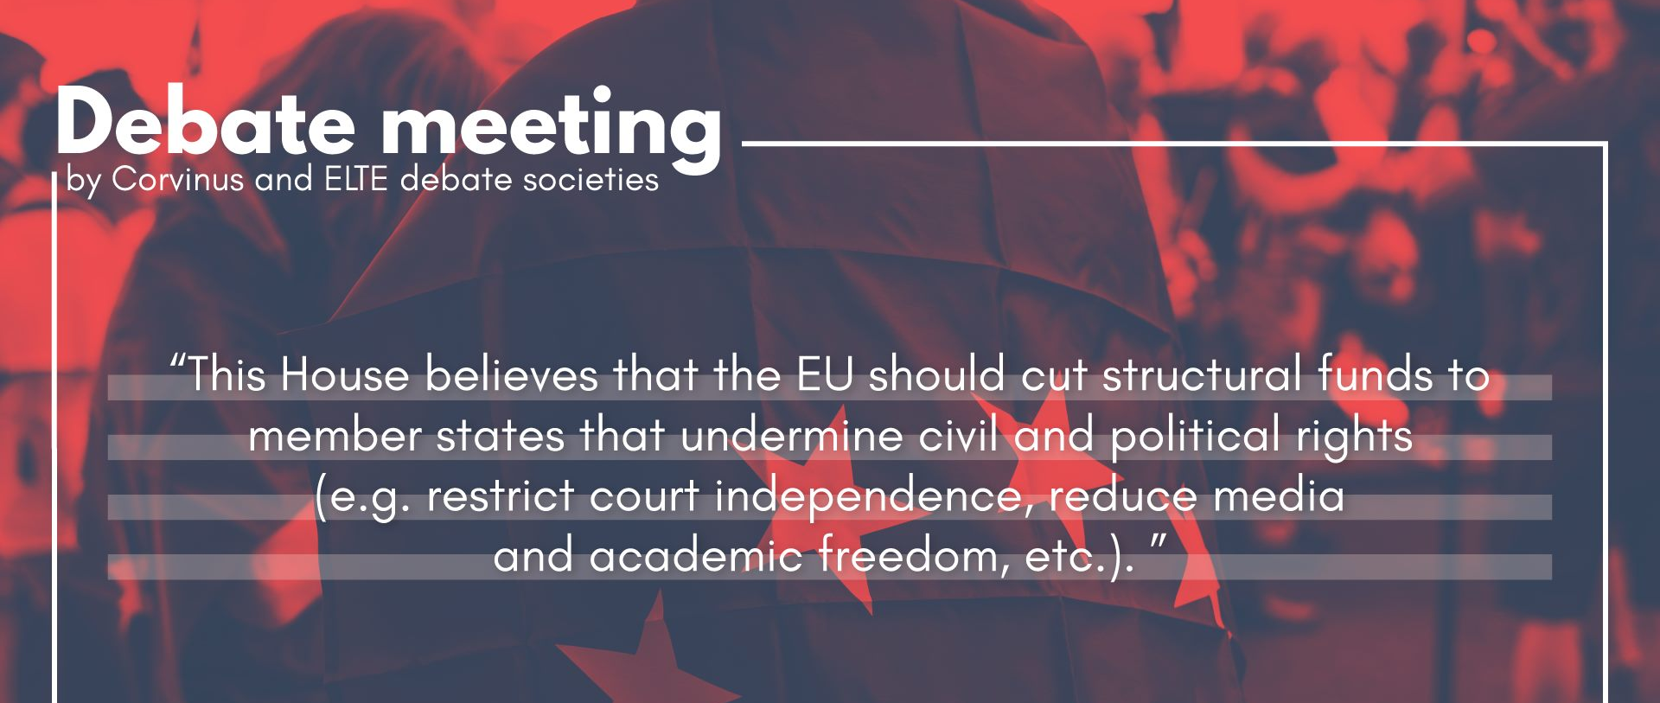
Motion:

